Slide 1

BETTER TOMORROW

Slide 2
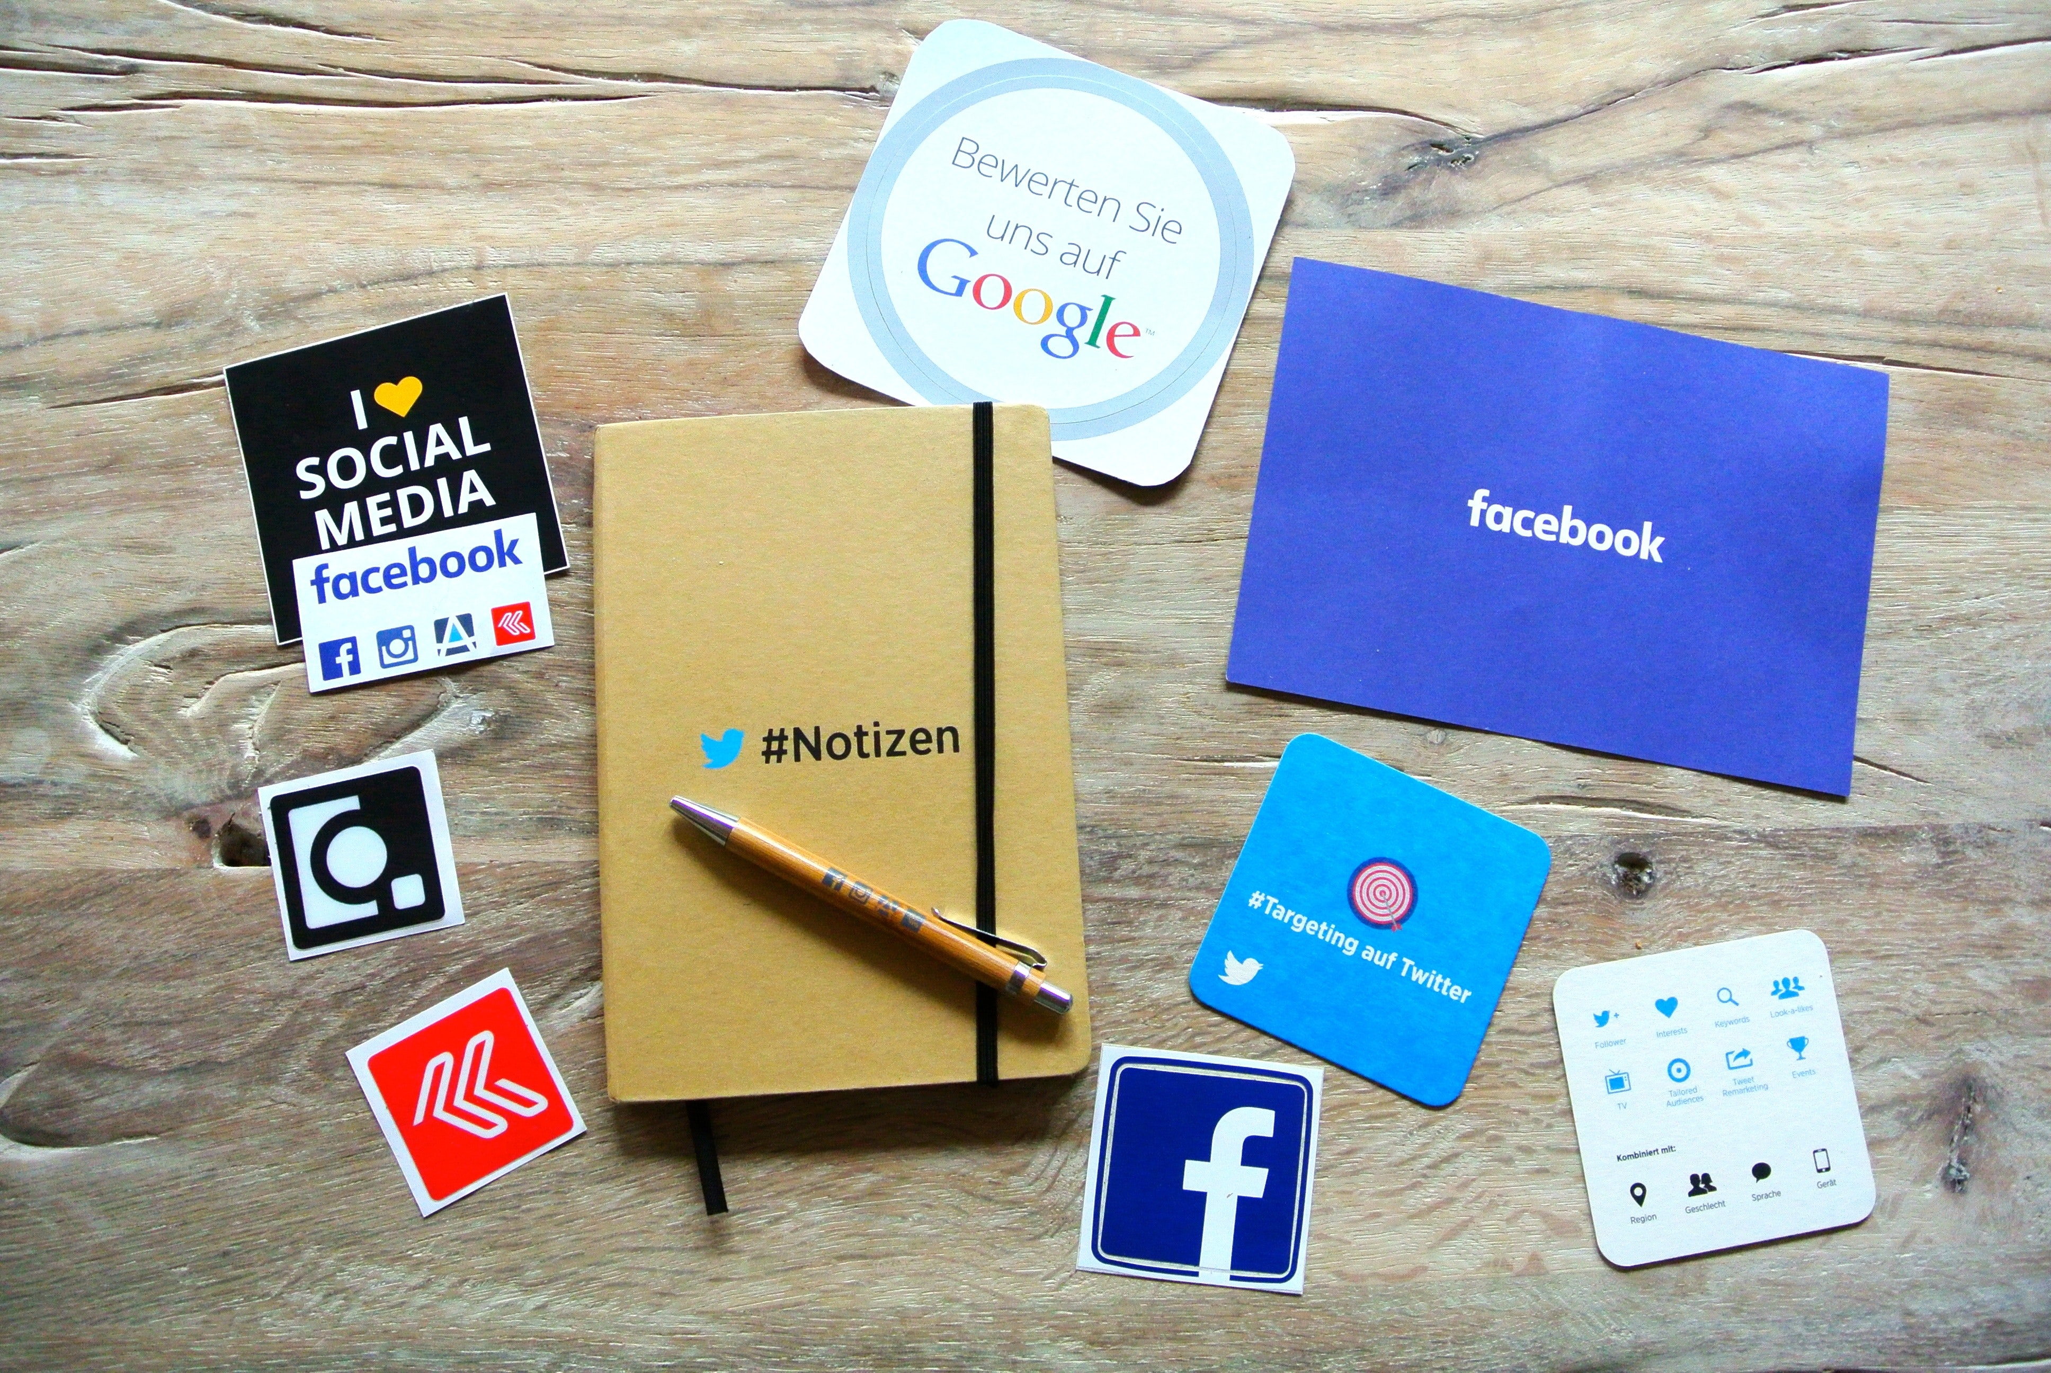

YOU WANT TO HELP, WE’LL TELL YOU HOW
How can we help Non Government Organizations to share their ideas and values?
Creating a Social Media just for them!

Slide 3




TECHNOLOGIES
To pursue our goal we used for the back-end:
Go
MongoDB
Front-end:
Bootstrap
ReactJS

